Slide 1
Spring Core
Spring Framework

Slide 2
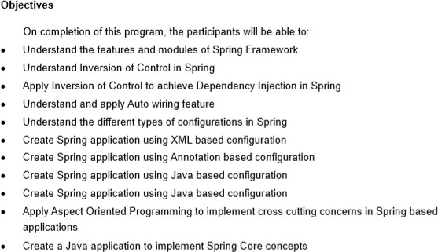
Course Objectives

Slide 3
Building Web Applications
Simple Application
Complex
Application
Scripting elements calling servlet code directly
Scripting elements calling servlet code indirectly (by means of utility
classes)
Beans
Servlet/JSP combo (MVC 2 Architecture)
MVC with JSP expression language (JSTL)
Custom tags
MVC with beans and a framework like Struts or JSF or Spring

Slide 4
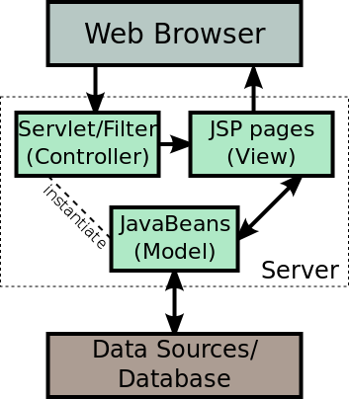
MVC Model 2 Architecture
MVC based frameworks are: Struts 2 , JSF , Spring etc.
In JSP Model 2 architecture , JSP is used for creating the view for the application.
A centralized Servlet is used to handle all the request for the application. The Servlet works as the controller for the application. It then uses the Java beans for processing the business logic and getting the data (Model) from the database.
Finally it uses the JSP to render the view which is displayed to the user.

Slide 5
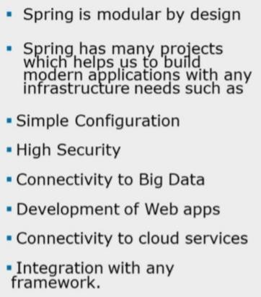
Spring Projects at a glance
http://spring.io/projects
Spring Framework
Spring Data
Spring Boot
Spring Integration
Spring Batch
Spring Security
Spring Hateoas
Spring Social
Spring AMQP
Spring REST Docs
Spring Mobile
Spring For Android
Spring Web Flow
Spring Web Services
Spring LDAP
Spring Cloud
Spring Scala
Spring ROO
Spring Flo
Spring Session

Slide 6
Introduction to the Spring Framework
The Spring Framework provides comprehensive infrastructure support for developing Java applications.
Spring handles the infrastructure so you can focus on your application.
Spring enables you to build applications from "plain old Java objects" (POJOs) and to apply enterprise services non-invasively to POJOs.
The Spring Framework is an open source application framework and inversion of control container for the Java platform.

Slide 7

Introduction to the Spring Framework
The first version was written by Rod Johnson in October 2002. The framework was first released under the Apache 2.0 license in June 2003
Version | Date
0.9 | 2002
1.0 | 2003
2.0 | 2006
3.0 | 2009
4.0 | 2013
5.0 | 2017

Slide 8
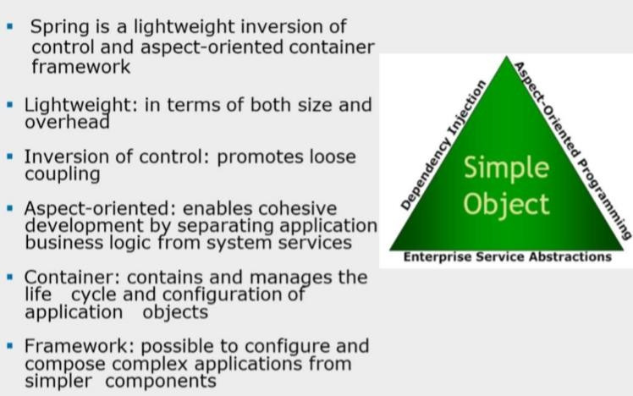
Spring Framework

Slide 9
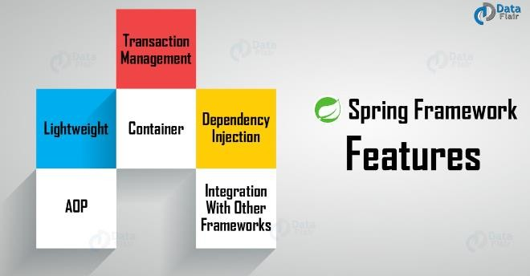
Spring Framework

Slide 10
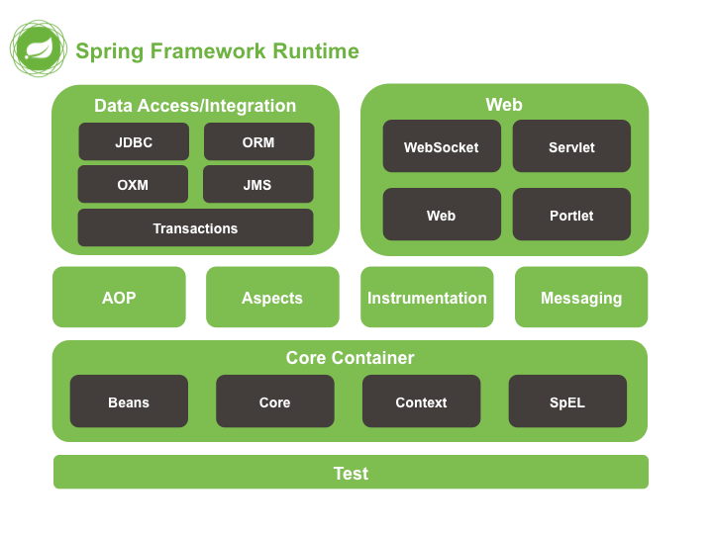
Spring Framework
The Spring Framework consists of features organized into about 20
modules.
The spring-core and spring-beans modules provide the fundamental parts of the framework, including the IoC and Dependency Injection features.

Slide 11
The Spring IoC Container
The basic concept of the Inversion of Control pattern (also known as dependency injection) is that we do not create our objects but describe how they should be created.
The IoC container enforces the dependency injection pattern for our components, leaving them loosely coupled and allowing us to code to abstractions.
The org.springframework.beans and org.springframework.context packages are the basis for Spring Framework’s IoC container

Slide 12
Dependency Injection (DI)
Martin Fowler, a British software engineer popularized the
term Dependency Injection as a form of Inversion of Control, identifies three ways in which an object can receive a reference to an external module:
Three types of dependency injection
constructor injection: the dependencies are provided through a class constructor.
setter injection: the client exposes a setter method that the injector
uses to inject the dependency.
interface injection: the dependency provides an injector method that will inject the dependency into any client passed to it. Clients must implement an interface that exposes a setter method that accepts the dependency.
Note: Spring supports constructor and setter injection.
13

Slide 13

Constructor Injection Example
dependent class
dependency interface
IAddress
public abstract methods
dependency
class
AddressImpl
Customer
IAddress address;
private string hno; private string street; private string city; private string state private string country; private string zip;
// method implementations
public Customer(IAddress address){ this.address=address;
}
Constructor method
14
IoC container creates instance of dependency class, Address and passes to the constructor method of dependent class, Customer

Slide 14
Setter Injection Example
dependency interface
IAddress
public abstract methods
dependency
class
AddressIm
pl
Customer
private string hno; private string street; private string city; private string state private string country; private string zip;
// method implementations
IAddress address;
public setAddress(IAddress
address){
this.address=address;
}
dependent
class
setter
method
IoC container creates instance of dependency class, Address and passes to the setter method of dependent class, Customer
15

Slide 15
Interface Injection Example
IAddressInjector
IAddress
void injectAddress(IAddress address);
public abstract methods
Customer
AddressImpl
IAddress address
public void injectAddress(IAddress address){
this.address=address;
}
private string hno; private string street; private string city; private string state private string country; private string zip;
// method implementations
16

Slide 16
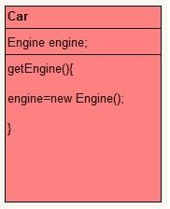
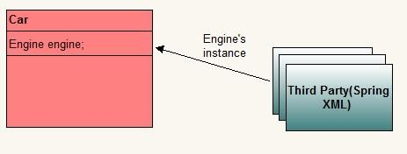
Inversion of Control and Dependency Injection
Inversion of control (IoC) is at the heart of Spring framework.
Normal Method
Dependency Injection

Slide 17
Inversion of Control and Dependency Injection
The container is responsible for managing object lifecycles of specific objects: creating these objects, calling their initialization methods, and configuring these objects by wiring them together.
Objects created by the container are also called managed objects or beans.
The container can be configured by loading XML (Extensible Markup Language) files or detecting specific Java annotations on configuration classes.
These data sources contain the bean definitions that provide the
information required to create the beans.

Slide 18
Bean Factory and Application Context
In Spring, the application objects will live within the Spring container.
The Spring IOC container is mainly responsible for creating the objects, wiring them together, configuring them and managing their complete lifecycle i.e. from initializing to destruction.
There are various implementations of Spring Containers.
The two most common implementations are:
BeanFactory (org.springframework.beans package) and
ApplicationContext (org.springframework.context package)

Slide 19
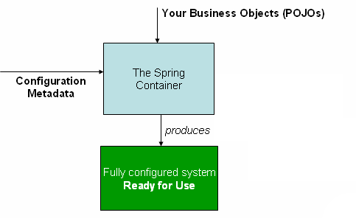
The Spring IoC container
High-level view of how Spring works.
Our application classes are combined with configuration metadata so that after the ApplicationContext is created and initialized, we have a fully configured and executable system or application.

Slide 20
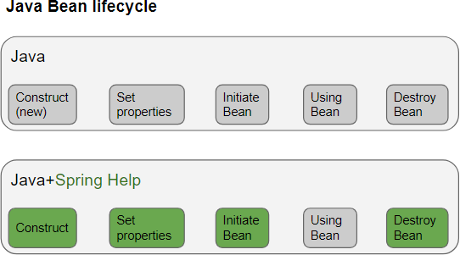
Java Bean Lifecycle

Slide 21
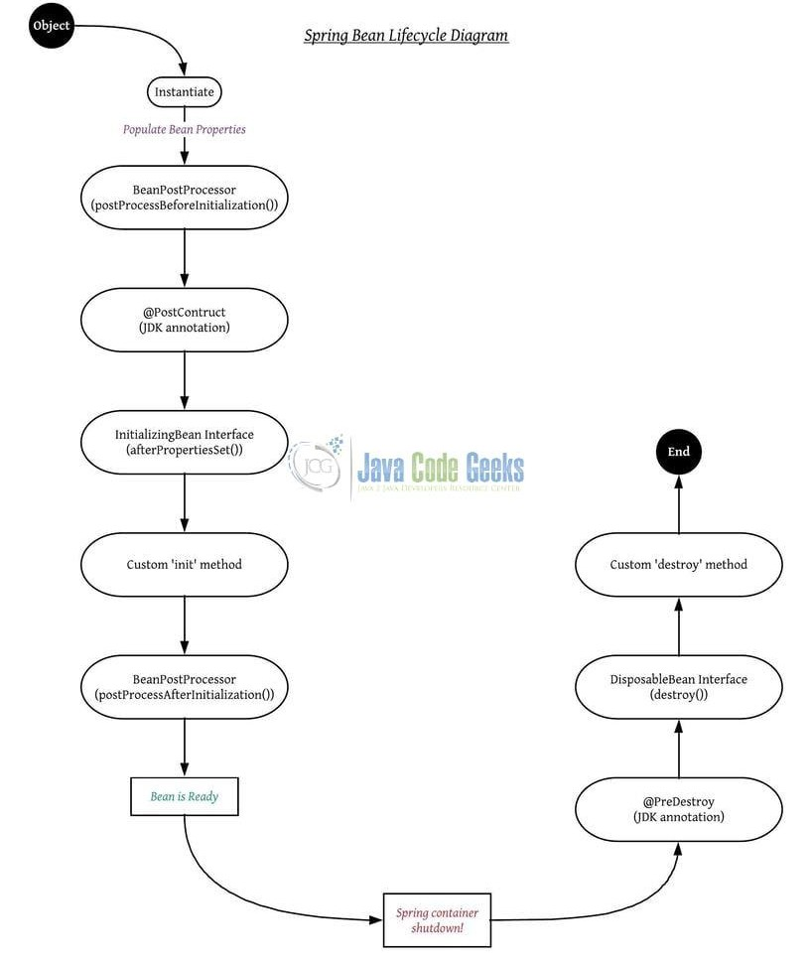
@PostConstruct is a JSR-250 annotation while init-method is Spring's way of having an initializing method.
If you have a @PostConstruct method, this will be called first before the initializing methods are called.
If your bean implements InitializingBean and overrides afterPropertiesSet , first @PostConstruct is called, then the afterPropertiesSet and then init-method.
A bean post processor allows additional processing before and
after the bean initialization callback method.
Spring Bean Lifecycle

Slide 22
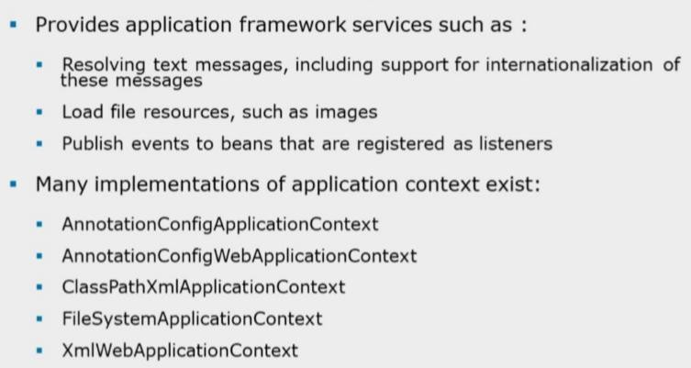
Bean Container : ApplicationContext

Slide 23
Implementations of ApplicationContext
Several implementations of the ApplicationContext interface are supplied out- of-the-box with Spring.
The Three most commonly used implementations of ApplicationContext are:
FileSystemXmlApplicationContext, ClassPathXmlApplicationContext and XmlWebApplicationContext
Example:
ApplicationContext context = new FileSystemXmlApplicationContext("c://applicationContext.xml");
ApplicationContext context = new
ClasspathXmlApplicationContext("applicationContext.xml");

Slide 24
Configuration Metadata
Configuration metadata is traditionally supplied in a simple XML format.
Other forms of metadata with the Spring container:
Annotation-based configuration: Spring 2.5 introduced support for
annotation-based configuration metadata.
Java-based configuration: Starting with Spring 3.0,

Slide 25
XML-based configuration metadata
<?xml version="1.0" encoding="UTF-8"?>
<beans xmlns="http://www.springframework.org/schema/beans" xmlns:xsi="http://www.w3.org/2001/XMLSchema-instance" xsi:schemaLocation="http://www.springframework.org/schema/beans http://www.springframework.org/schema/beans/spring-beans.xsd">
<bean id="..." class="...“>
<!-- collaborators and configuration for this bean go here -->
</bean>
<bean id="..." class=“...">
<!-- collaborators and configuration for this bean go here -->
</bean>
<!-- more bean definitions go here -->
</beans>
Note : Create source folder, resource and place configuration file in stand-alone projects
The id attribute is a string that you use to identify the individual bean definition.
The class attribute defines the type of the bean and uses the fully qualified class name.

Slide 26
Versionless XSD
It is recommended to use the "versionless" XSDs, because they're mapped
to the current version of the framework you're using in your application.
So, instead of writing spring-beans-4.0.xsd write as spring-beans.xsd
Applications and tools should never try to fetch those XSDs from the web,
since those schemas are included in the JARs.
If they do, it usually means your app is trying to use a XSD that is more recent than the framework version you're using, or that your IDE/tool is not properly configured.

Slide 27
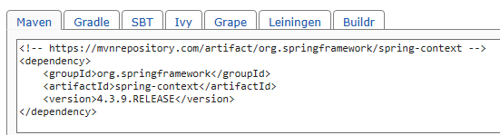
Sample Spring application using Maven build tool
…….
pom.xml
<properties>
<project.build.sourceEncoding>UTF-8</project.build.sourceEncoding>
<spring.version>4.3.9.RELEASE</spring.version>
</properties>
<dependencies>
<dependency>
<groupId>org.springframework</groupId>
<artifactId>spring-core</artifactId>
<version>4.3.9.RELEASE</version>
</dependency>
<dependency>
<groupId>org.springframework</groupId>
<artifactId>spring-context</artifactId>
<version>4.3.9.RELEASE</version>
</dependency>
<dependency>
<groupId>junit</groupId>
<artifactId>junit</artifactId>
<version>3.8.1</version>
<scope>test</scope>
</dependency>
</dependencies>
………

Slide 28
Instantiating a container
Instantiating a Spring IoC container is straightforward.
The location path or paths supplied to an ApplicationContext constructor are actually resource strings that allow the container to load configuration metadata from a variety of external resources such as the local file system, from the Java CLASSPATH, and so on.
ApplicationContext context =
new ClassPathXmlApplicationContext(new String[] {"services.xml", "daos.xml"});
ApplicationContext context =
new ClassPathXmlApplicationContext(“application-context.xml”);

Slide 29
Address and Person POJOs
public class Address { private String houseNumber; private String street;
private String city; private String state; private String country; private Long pinCode;
…
}
public class Person { private Long adharCardNumber; private String personName;
private Address residentialAddress; private Address permanentAddress;
…
}

Slide 30
spring.xml
<?xml version="1.0" encoding="UTF-8"?>
<beans xmlns="http://www.springframework.org/schema/beans" xmlns:context="http://www.springframework.org/schema/context" xmlns:xsi="http://www.w3.org/2001/XMLSchema-instance" xsi:schemaLocation=" http://www.springframework.org/schema/beans http://www.springframework.org/schema/beans/spring-beans.xsd http://www.springframework.org/schema/context
http://www.springframework.org/schema/context/spring-context.xsd" xmlns:c="http://www.springframework.org/schema/c" xmlns:p="http://www.springframework.org/schema/p">
<bean id="addressBean1" class="com.varaunited.trg.model.Address" >
<property name="houseNumber" value="3-4-178/3" />
<property name="street" value="Queens Street"></property>
<property name="city" value="Hyderabad"></property>
<property name="state" value="Telanaga"></property>
<property name="country" value="India"></property>
<property name="pinCode" value="500028"></property>
</bean>
<bean id="addressBean2" class="com.varaunited.trg.model.Address" c:houseNumber="5-6-167/8" c:street="Kings Street" c:city="Hyderabad" c:state="Telangana" c:country="India" c:pinCode="500029" >
</bean>
<bean id="personBean" class="com.varaunited.trg.model.Person">
<constructor-arg name="adharCardNumber" value="786745352879"/>
<constructor-arg name="personName" value="Smith"/>
<constructor-arg name="residentialAddress" ref="addressBean1"/>
<constructor-arg name="permanentAddress" ref="addressBean2"/>
</bean>
</beans>

Slide 31
Tester class
public class App {
public static void main( String[] args ) ApplicationContext context=
{
new ClassPathXmlApplicationContext("spring.xml");
Address address1= (Address) context.getBean("addressBean1"); System.out.println(address1);
Address address2= (Address) context.getBean("addressBean2");
System.out.println(address2);
Person person=(Person) context.getBean("personBean"); System.out.println(person.getAdharCardNumber()); System.out.println(person.getPersonName());
/*((AbstractApplicationContext)context).close();*/
((AbstractApplicationContext)context).registerShutdownHook();
}
}

Slide 32
Constructor Namespaces ( P’s and C’s)
<?xml version="1.0" encoding="UTF-8"?>
<beans ……… xmlns:c="http://www.springframework.org/schema/c" xmlns:p="http://www.springframework.org/schema/p">
<bean class="org.springframework.beans.factory.config.PropertyPlaceholderConfigurer
<property name="locations" value="classpath:messages.properties"/>
</bean>
<bean id="addressBean3" class="com.varaunited.trg.model.Address" c:houseNumber="5-6-167/8" c:street="Kings Street" c:city="Hyderabad" c:state="Telangana" c:country="India" c:pinCode="500029" init-method="initializeBean"
destroy-method="destroyBean" scope="prototype" autowire-candidate="false">
</bean>
<bean id="addressBean4" class="com.varaunited.trg.model.Address" p:houseNumber="5-6-197/1" p:street="Queens Street" p:city="Hyderabad" p:state="Telangana" p:country="India" p:pinCode="500029" autowire-candidate="false">
</bean>
</beans>

Slide 33
Bean Properties
Properties | Description
class | This attribute is mandatory and specify the bean class to be used to create the bean.
name | This attribute specifies the bean identifier uniquely. In XML-based configuration metadata, you use the id and/or name attributes to specify the bean identifier(s).
scope | This attribute specifies the scope of the objects created from a particular bean definition
constructor-arg | This is used to inject the dependencies
properties | This is used to inject the dependencies.
autowiring mode | This is used to inject the dependencies .
lazy-initialization mode | A lazy-initialized bean tells the IoC container to create a bean instance when it is first requested, rather than at startup.
initialization method | A callback to be called just after all necessary properties on the bean have been set by the container.
destruction method | A callback to be used when the container containing the bean is destroyed.

Slide 34
Bean Scope
When defining a <bean> in Spring, you have the option of declaring a
scope for that bean.
If you want Spring to return the same bean instance each time one is needed, you should declare the bean's scope attribute to be singleton (which is default).
To force Spring to produce a new bean instance each time one is needed, you should declare the bean's scope attribute to be prototype.

Slide 35
Bean Scopes
The Spring Framework supports following five scopes, three of which are available only if you use a web-aware ApplicationContext.
Scope | Description
singleton | This scopes the bean definition to a single instance per Spring IoC container (default).
prototype | This scopes a single bean definition to have any number of object instances.
request | This scopes a bean definition to an HTTP request. Only valid in the context of a web-aware Spring ApplicationContext.
session | This scopes a bean definition to an HTTP session. Only valid in the context of a web-aware Spring ApplicationContext.
global-session | This scopes a bean definition to a global HTTP session. Only valid in the context of a web-aware Spring ApplicationContext.

Slide 36
The singleton scope
The singleton scope:
If scope is set to singleton, the Spring IoC container creates exactly one instance of the
object defined by that bean definition.
The default scope is always singleton
Message message1 = (Message) applicationContext.getBean("messageBean");
System.out.println(message1);
Message message2=(Message) applicationContext.getBean("messageBean");
System.out.println(message2);
If scope is set to prototype, the Spring IoC container creates new bean instance of the object every time a request for that specific bean is made by calling getBean() method.
As a rule, use the prototype scope for all stateful beans and the singleton scope for
stateless beans.

Slide 37
Stateless and Stateful beans
Stateless beans: beans that are singleton and are initialized only once. The only state they have is a shared state.
These beans are created while the ApplicationContext is being initialized. The same bean instance will be returned/injected during the lifetime of this
ApplicationContext.
Stateful beans: beans that can carry state (instance variables).
These are created every time an object is required (like using the "new"
operator in java).

Slide 38
The prototype scope
<!-- A bean definition with singleton scope -->
<bean id="..." class="..." scope="prototype">
<!-- collaborators and configuration for this bean go here -->
</bean>
Message message1 = (Message) applicationContext.getBean("messageBean"); message1.setMessage("Welcome to Spring4 framework!"); System.out.println(message1.getMessage()); System.out.println(message1);
Message message2=(Message)applicationContext.getBean("messageBean"); System.out.println(message2); System.out.println(message2.getMessage());
The objects references( hexadecimal representation of object’s hash code) are displayed.

Slide 39
Bean Life Cycle
When a bean is instantiated, it may be required to perform some initialization to get it into a usable state.
Similarly, when the bean is no longer required and is removed from the container,
some cleanup may be required.
Though, there are list of the activities that take place behind the scenes between the time of bean Instantiation and its destruction, two important bean lifecycle callback methods are required at the time of bean initialization and its destruction.
To define setup and teardown for a bean, we simply declare the <bean> with init- method and/or destroy-method parameters.
The init-method attribute specifies a method that is to be called on the bean
immediately upon instantiation.
Similarly, destroy-method attribute specifies a method that is called just before a bean is removed from the container.

Slide 40
Initialization Callbacks
Initialization callbacks:
The org.springframework.beans.factory.InitializingBean interface specifies a single method:
void afterPropertiesSet() throws Exception; So you can simply implement above interface and initialization work can be done inside afterPropertiesSet() method as follows:
public class ExampleBean implements InitializingBean { public void afterPropertiesSet() {
// do some initialization work
}
}
Alternatively, We can provide the information in XML-based configuration metadata
In the case of XML-based configuration metadata, you can use the init-method attribute to specify the name of the method that has a void no-argument signature.
For example:
<bean id="exampleBean" class="examples.ExampleBean" init-method="init"/>
Following is the class definition:
public class ExampleBean { public void init() { // do some initialization work } }

Slide 41
Destruction Callbacks
The org.springframework.beans.factory.DisposableBean interface specifies a single method:
void destroy() throws Exception; So you can simply implement above interface and
finalization work can be done inside destroy() method as follows:
public class ExampleBean implements DisposableBean { public void destroy() {
// do some destruction work
}
}
Alternatively, We can provide the information in XML-based configuration metadata
<bean id="exampleBean" class="examples.ExampleBean" destroy-method="destroy"/>
Following is the class definition:
public class ExampleBean {
public void destroy() {
// do some closure work
}
}

Slide 42
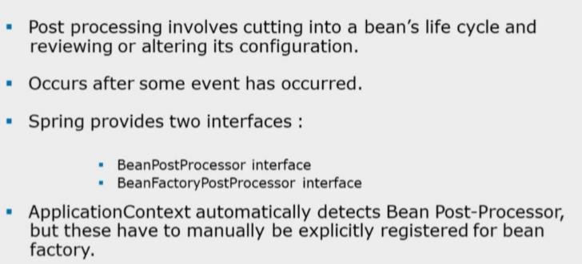
Customizing beans with BeanPostProcessor

Slide 43
Customizing beans with BeanPostProcessor
A bean post processor allows additional processing before and after the bean initialization callback method.
Typically, bean post processors are used for checking the validity of bean properties or altering bean properties according to certain criteria.
ApplicationContext automatically detects BeanPostProcessor

Slide 44
Loading ResourceBundle by Spring IoC container
package com.deloitte.businesstier;
public class HelloWorld { private String message1; private String message2;
public HelloWorld(){
}
public HelloWorld(String message1, String message2) {
super();
this.message1 = message1; this.message2 = message2;
}
public String getMessage1() { return message1;
}
public void setMessage1(String message1) {
this.message1 = message1;
}
public String getMessage2() { return message2;
}
public void setMessage2(String
message2) {
this.message2 = message2;
}
}

Slide 45
Loading ResourceBundle by Spring IoC container
messages.properties
Note: Place static files in project’s classpath
greet=Hello Spring
stream=Java EE
spring-resource.xml
<?xml version="1.0" encoding="UTF-8"?>
<beans xmlns="http://www.springframework.org/schema/beans" xmlns:context="http://www.springframework.org/schema/context" xmlns:xsi="http://www.w3.org/2001/XMLSchema-instance" xsi:schemaLocation=" http://www.springframework.org/schema/beans http://www.springframework.org/schema/beans/spring-beans.xsd http://www.springframework.org/schema/context
http://www.springframework.org/schema/context/spring-context.xsd">
<bean class="org.springframework.beans.factory.config.PropertyPlaceholderCon figurer">
<property name="locations" value="classpath:messages.properties"/>
</bean>
</beans>

Slide 46
Loading ResourceBundle by Spring IoC container
spring-hello.xml
<?xml version="1.0" encoding="UTF-8"?>
<beans xmlns="http://www.springframework.org/schema/beans" xmlns:context="http://www.springframework.org/schema/context" xmlns:xsi="http://www.w3.org/2001/XMLSchema-instance" xsi:schemaLocation=" http://www.springframework.org/schema/beans http://www.springframework.org/schema/beans/spring-beans.xsd http://www.springframework.org/schema/context
http://www.springframework.org/schema/context/spring-context.xsd">
<import resource="spring-resource.xml"/>
<bean id="helloBean" class="com.deloitte.businesstier.HelloWorld">
<constructor-arg index="0" value="${greet}"/>
<constructor-arg index="1" value="${stream}"></constructor-arg>
</bean>
</beans>

Slide 47
Loading ResourceBundle by Spring IoC container
package com.deloitte.presentationtier;
import org.springframework.context.ApplicationContext;
import org.springframework.context.support.ClassPathXmlApplicationContext;
import com.deloitte.businesstier.HelloWorld; public class Tester {
public static void main(String[] args) { ApplicationContext context=
new ClassPathXmlApplicationContext("spring-hello.xml");
HelloWorld helloWorld=(HelloWorld)context.getBean("helloBean"); System.out.println(helloWorld.getMessage1()); System.out.println(helloWorld.getMessage2());
}
}

Slide 48
Injecting collections
Spring offers three types of collection configuration elements which are as follows:
Element | Description
<list> | This helps in wiring i.e. injecting list of values, allowing duplicates.
<set> | This helps in wiring a set of values but without any duplicates.
<map> | This can be used to inject a collection of name-value pairs where name and value can be of any type.

Slide 49
Spring Configuration file
…….
<bean id= "countryBean" class=“com.deloitte.businesstier.Country“>
<property name=“countryList">
<list>
<value>INDIA</value>
<value>UK</value>
<value>USA</value>
<value>USA</value>
</list>
</property>
…….
<property name=“countryMap">
public class Country {
private List<String> countryList; private Set<String> countrySet;
private Map<String,String> countryMap;
// setter and getter methods for other properties
}
<map>
<entry key="1" value="INDIA"/>
<entry key="2" value=“UK"/>
<entry key="3" value="USA"/>
<entry key="4" value="USA"/>
</map>
</property>
…….

Slide 50
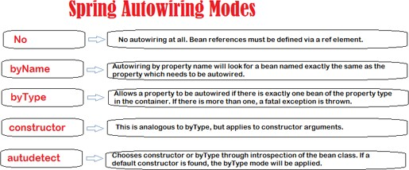
Auto-Wiring Modes
The autowiring functionality has five modes. The default mode is no i.e. by default autowiring is turned off.

Slide 51
Spring bean autowire byType example
public class Employee{
private String fullName;
private Department department;
public class Department { private String name; public String getName() {
return name;
}
public void setName(String name) {
this.name = name;
}
}
public Department getDepartment() { return department;
}
public void setDepartment(Department department) {
this.department = department;
}
…..
……..
<bean id="employeeBean" class= " com.deloitte.businesstier.Employee" autowire="byType">
<property name="fullName" value="Ravi Kumar"/>
</bean>
<bean id="departmentBean" class="com.deloitte.businesstier.Department" >
<property name="name" value="Human Resources" />
</bean>
….

Slide 52
Spring bean autowire byName example
In Spring, Autowiring by Name means, if the bean Id is same as the property name of other bean, auto wire it.
public class Employee{
private String fullName;
private Department department;
public class Department { private String name; public String getName() {
return name;
}
public void setName(String name) { this.name = name;
}
}
public Department getDepartment() { return department;
}
public void setDepartment(Department department) {
this.department = department;
}
……..
…..
<bean id="employeeBean" class= " com.deloitte.businesstier.Employee" autowire="byName">
<property name="fullName" value="Ravi Kumar"/>
</bean>
<bean id="department" class="com.deloitte.businesstier.Department" >
<property name="name" value="Human Resources" />
</bean>

Slide 53
Spring Annotations

Slide 54
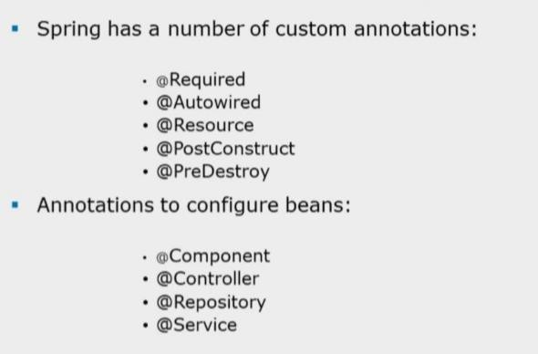
Spring Annotations

Slide 55
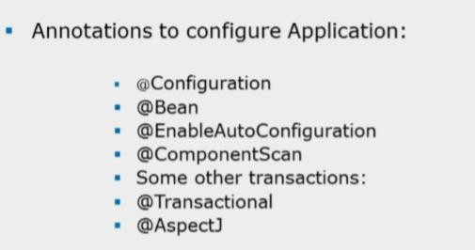
Spring Annotations

Slide 56
Spring Annotations
 | Spring MVC Annotations
@Controller | import org.springframework.stereotype.Controller;
@RequestMapping | import org.springframework.web.bind.annotation.RequestMapping;
@PathVariable | import org.springframework.web.bind.annotation.PathVariable;
@RequestParam | import org.springframework.web.bind.annotation.RequestParam;
@ModelAttribute | import org.springframework.web.bind.annotation.ModelAttribute;
@SessionAttributes | import org.springframework.web.bind.annotation.SessionAttributes;
 | Spring Security Annotations
@PreAuthorize | import org.springframework.security.access.prepost.PreAuthorize;

Slide 57
Spring Annotations
Once <context:annotation-config/> is configured, we can start annotating our code to indicate that Spring should automatically wire values into properties, methods, and constructors.
Few important annotations to understand how they work:
S.N. | Annotation & Description
1 | @Required The @Required annotation applies to bean property setter methods.
2 | @Autowired The @Autowired annotation can apply to bean property setter methods, non-setter methods, constructor and properties. (specify <context:annotation-config/> in configuration file)
3 | @Qualifier The @Qualifier annotation along with @Autowired can be used to remove the ambiguity by specifying exactly which bean to be wired.
4 | JSR-250 Annotations Spring supports JSR-250 based annotations which include @Resource, @PostConstruct and @PreDestroy annotations ( which are part of javax.annotation package that comes along with Java EE 5 platform).

Slide 58
Spring Annotations
For spring to process annotations, add the following lines in your application-
context.xml file.
<context:annotation-config />
Note:
Spring supports both Annotation based and XML based configurations.
We can even mix them together in which case Annotation injection is performed before XML injection, thus the later configuration will override the former for properties wired through both approaches.

Slide 59
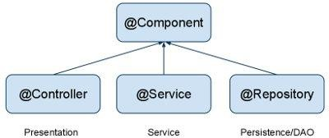
@Component Spring Annotation
@Component is a generic stereotype for any Spring-managed component.
@Repository, @Service, and @Controller are specializations of @Component for more specific use cases, for example, in the persistence, service, and presentation layers, respectively.
@Component (and @Service and @Repository) are used to auto-detect and auto-
configure beans using class path scanning.
There's an implicit one-to-one mapping between the annotated class and the bean (i.e. one bean per class).

Slide 60
@Service, @Repository and @Component Annotations
@Service
Annotate all your service classes with @Service. All your business logic should be in Service classes.
@Service
public class CompanyService implements ICompanyService {
@Autowired
private ICompanyDAO companyDAO;
}
@Repository
Annotate all your DAO classes with @Repository. All your database access logic should be in DAO classes.
@Repository
public class CompanyDAO implements ICompanyDAO {
...
}
@Controller
To annotate classes of client/web layer.
@Controller
public class CompanyController {
...
}

Slide 61
@Autowired Annotation
Spring beans can be wired byName or byType.
@Autowired by default is a type driven injection.
Autowired byName
Example:
@Autowired(required=false) @Qualifier(value="addressBean1") private Address residentialAddress;
Note:
@Qualifier is Spring framework annotation
while @Resource is Java EE annotation
@Autowired(required=false)
@Qualifier(value="addressBean2")
OR
@Resource(name="addressBean2") private Address permanentAddress;

Slide 62
@Scope Spring Annotation
@Scope
As with Spring-managed components in general, the default and most common scope for auto-detected components is singleton. To change this default behaviour, use @Scope spring annotation.
@Component
@Scope("prototype")
public class ClassName {
...
}
Note: request, session & global-session are applicable for web applications

Slide 63
Spring Java Based Configuration
Java based configuration option enables you to write most of your Spring configuration without XML but with the help of few Java-based annotations explained below.
@Configuration & @Bean Annotations
Annotating a class with the @Configuration indicates that the class can be used by the Spring IoC container as a source of bean definitions. (acts like a configuration file).
The @Bean annotation tells Spring that a method annotated with @Bean will return an object that should be registered as a bean in the Spring application context.

Slide 64
Spring Java Based Configuration
The simplest possible @Configuration class would be as follows:
@Configuration
public class HelloWorldConfig {
HelloWorldConfig .java
@Bean
public HelloWorld helloWorld(){ return new HelloWorld();
}
}
Above code will be equivalent to the following XML configuration:
<beans> <bean id="helloWorld" class=“com.deloitte.businesstier.HelloWorld" /> </beans>
Here the method name annotated with @Bean works as bean ID and it creates and returns actual bean.
The above configuration class can have declaration for more than one @Bean

Slide 65
Java Based Configuration Example
@Configuration
public class JavaBasedConfiguration {
@Bean(name="addressBean1")
public Address setHouseAddress(){
return new Address("3-4-569","MG Road","Bangalore","Karnataka","India",400156L);
}
@Bean(name="addressBean2")
public Address setOfficeAddress(){
return new Address("3-4-570","Kings Road","Bangalore","Karnataka","India",400156L);
}
@Bean(name="customerBean") public Customer setCustomer(){ return new
Customer("101","Jones",setHouseAddress(),setOfficeAddress(),"jones@gmail.com");
}
}

Slide 66
Java Based Configuration Example
public class JavaConfigureTester {
public static void main(String[] args) { ApplicationContext context=
new AnnotationConfigApplicationContext(JavaBasedConfiguration.class);
Customer customer=(Customer) context.getBean("customerBean"); System.out.println(customer);
}
}
Loading multiple configuration classes :
AnnotationConfigApplicationContext context = new AnnotationConfigApplicationContext(); context.register(AppConfig.class, OtherConfig.class); context.register(AdditionalConfig.class);

Slide 67
Configuration data
One can choose the following methods for providing configuration data:
Using XML file
Only Java Annotations
Java Annotations with minimal XML file
Java Configuration file - a java class with appropriate annotations

Slide 68
Event Handling in Spring
Spring has an eventing mechanism which is built around the ApplicationContext.
It can be used to exchange information between different beans.
We can make use of application events by listening for events and executing custom code.

Slide 69
Standard Context Events
In fact, there’re a variety of built-in events in Spring, that lets a developer hook into the lifecycle of an application and the context and do some custom operation.
Even though we rarely use these events manually in an application, the framework uses it extensively within itself.
Event handling in the ApplicationContext is provided through the
ApplicationEvent class and ApplicationListener interface.
ContextRefreshedEvent:
On either initializing or refreshing the ApplicationContext, Spring raises
the ContextRefreshedEvent. Typically a refresh can get triggered multiple times as long as the context has not been closed.
Notice that, we can also have the event triggered manually by calling the refresh() method
on the ConfigurableApplicationContext interface.
ContextStartedEvent
ContextStoppedEvent
ContextClosedEvent

Slide 70
Event Listener in Spring
If a bean implements the ApplicationListener, then every time an ApplicationEvent
gets published to the ApplicationContext, that bean is notified.
To listen to a context event, a bean should implement the ApplicationListener
interface which has just one method onApplicationEvent().
public class CStartEventHandler implements ApplicationListener<ContextStartedEvent>{ public void onApplicationEvent(ContextStartedEvent event) {
System.out.println("ContextStartedEvent Received");
}
}
public class CStopEventHandler implements ApplicationListener<ContextStoppedEvent>{ public void onApplicationEvent(ContextStoppeddEvent event) {
System.out.println("ContextStoppedEvent Received");
}
}

Slide 71
Event Listener in Spring
Starting from version 4.2, To consume the published events. Spring supports an annotation-driven event listener – @EventListener.
This will automatically register an ApplicationListener based on the signature of the method :
@EventListener
public void handleContextRefreshEvent(ContextStartedEvent ctxStartEvt) { System.out.println("Context Start Event received.");
}
@EventListener
public void handleContextStoppedEvent(ContextStoppedEvent ctxStopEvt) {
System.out.println("Context Stopped Event received.");
}

Slide 72
Running the Application
<bean id = "helloWorld" class = "com.trg.HelloWorld">
<property name = "message" value = "Hello World!"/> </bean>
<bean id = "cStartEventHandler" class = "com.trg.CStartEventHandler"/>
<bean id = "cStopEventHandler" class = "com.trg.CStopEventHandler"/>
public class MainApp {
public static void main(String[] args) {
ConfigurableApplicationContext context =
new ClassPathXmlApplicationContext("beans.xml");
// raise a start event.
context.start();
HelloWorld obj = (HelloWorld) context.getBean("helloWorld");
obj.getMessage();
// raise a stop
event. context.stop(); } }

Slide 73
Custom Event
Let’s create a simple event class – just a placeholder to store the event data. In this case, the event class holds a String message:
public class CustomSpringEvent extends ApplicationEvent {
private String message;
public CustomSpringEvent(Object source, String message) {
super(source); this.message = message;
}
public String getMessage() {
return message;
}
}

Slide 74
Publisher
Now let’s create a publisher of that event. The publisher constructs the event
object and publishes it to anyone who’s listening.
To publish the event, the publisher can simply inject the
ApplicationEventPublisher and use the publishEvent() API
@Component
public class CustomSpringEventPublisher { @Autowired
private ApplicationEventPublisher applicationEventPublisher;
public void doStuffAndPublishAnEvent(final String message) { System.out.println("Publishing custom event. ");
CustomSpringEvent customSpringEvent = new CustomSpringEvent(this, message);
applicationEventPublisher.publishEvent(customSpringEvent);
}
}

Slide 75
Listener
Finally, let’s create the listener.
The only requirement for the listener is to be a bean and
implement ApplicationListener interface:
@Component
public class CustomSpringEventListener implements ApplicationListener<CustomSpringEvent> { @Override
public void onApplicationEvent(CustomSpringEvent event) { System.out.println("Received spring custom event - " + event.getMessage());
}
}

Slide 76

Thank You!
77

